Slide 1
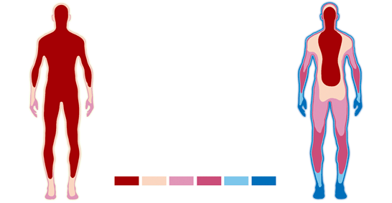
Homeostasis
Regulation of body temperature

Slide 2
Heat production
Heat is produced in the body by the release of energy during cellular respiration. Some of this energy is harnessed for cellular processes, much of it however is lost as heat.
Metabolic rate refers to how quickly food is broken down for energy release by the body.
Metabolic rate will increase significantly due to exercise.
Stress also increases metabolic rate as it stimulates the sympathetic division oof the nervous system.

Slide 3
Heat transfer – ways of gaining or losing heat
Radiation – no direct contact with the heat source. For example warming up by standing in sunlight.
Convection – when hot or cold air passes over the body. For example standing in front of a fan results in heat loss.
Conduction – when heat moves from a warmer object to a cooler object. The objects must come in contact with one another. For example standing on hot sand resulting in getting very hot feet.

Slide 4
Evaporation – cooling effect
Evaporation is the transformation of water from its liquid state to its gaseous state (i.e. steam or water vapour).
The evaporation of sweat results in heat loss

Slide 5
Temperature receptors
Thermoreceptors – monitor the temperature.
Peripheral receptors: found in the skin and mucous membranes
Cold receptors stimulated by lower environmental temperatures
Heat receptors stimulated by higher environmental temperatures.

Slide 6
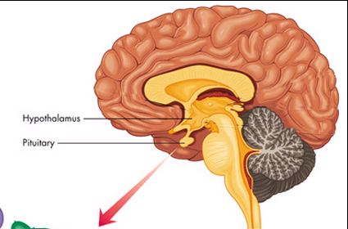
Temperature receptors
Central thermoreceptors – hypothalamus
Also found in the spinal cord and abdominal regions and connected back to the hypothalamus.
The hypothalamus receives information from the peripheral receptors

Slide 7
Behavioural Responses
In cold conditions:
Putting on a jumper, sheltering from the wind, curling into a ball
In hot conditions:
Removing clothing, turning on a fan, spreading out (increasing surface area)

Slide 8
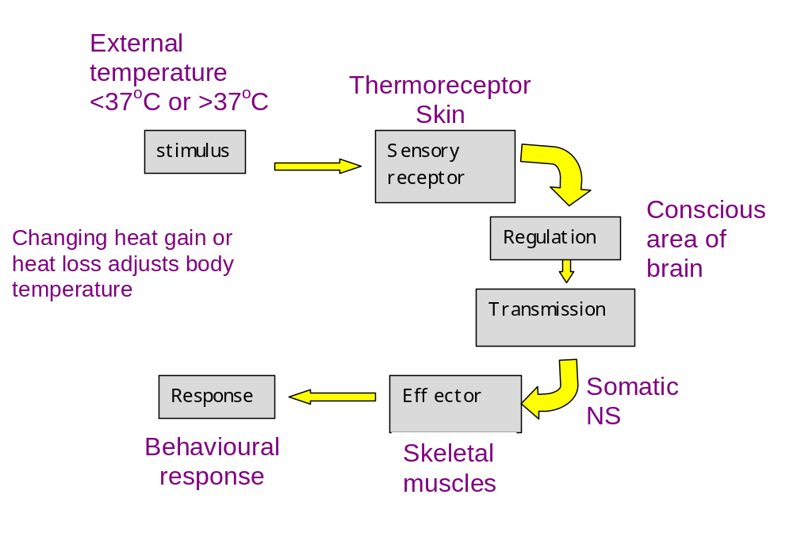
Behavioural Responses

Slide 9
Physiological Responses
In cold conditions:
Vasoconstriction
Shivering
Piloerection
Secretion of adrenaline and noradrenaline
Increase in thyroxine production
In hot conditions:
Vasodilation
Sweating

Slide 10
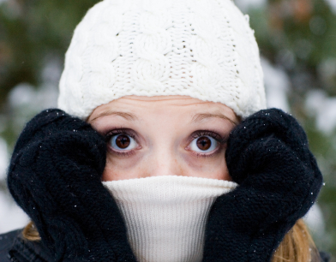
Response to low temperature

Slide 11
Vasoconstriction
Vasoconstriction: Contraction of the smooth muscle squeezes the arteriole and reduces blood flow to the skin. At the same time, pre-capillary sphincter muscles contract and stop blood flow into the cutaneous capillary beds. Less heat is lost from the surface of the body

Slide 12
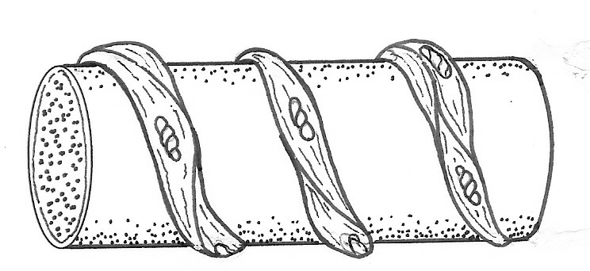
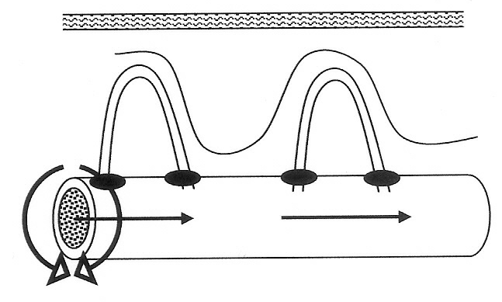
Vasoconstriction
Arteriole
Bands of smooth muscle
Sphincter muscles close
Vasoconstriction

Slide 13
Adrenaline and noradrenaline
The hypothalamus will stimulate the the adrenal medulla (sympathetic NS)
This causes the release of adrenaline and noradrenaline.
One of their many effects is an increase in cell metabolism (thereby increasing body temperature)

Slide 14
Shivering
The hypothalmus send stimuli to the part of the cerebral cortex that controls skeletal muscle tone.
Oscillating, rhythmic tremors occur at a rate of about 10 or 20 per second.
This increase in movement produces more metabolic heat, thereby increasing the temperature of the core.

Slide 15
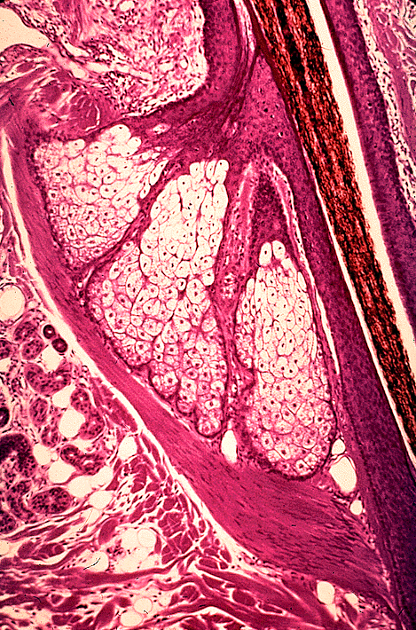
Piloerection
Hair shaft
When the arrector pili muscles contract the hair stands on end (piloerection) and gives us goose bumps.
Piloerection increase the thickness of dead air over the skin and reduces heat loss.
Because humans are not very hairy this is not a very effective mechanism.
Arrector pili muscle

Slide 16
Thyroxine – long term
Hypothalamus causes the anterior lobe of the pituitary to release increased amount of TSH (thyroid stimulating hormone)
The thyroid produces more thyroxine which in turn increases metabolic rate. This increase in metabolic rate produces more heat.
This response is slower to have an effect but is longer lasting. It is a change made by the body each year as the temperature drops heading toward winter.

Slide 17
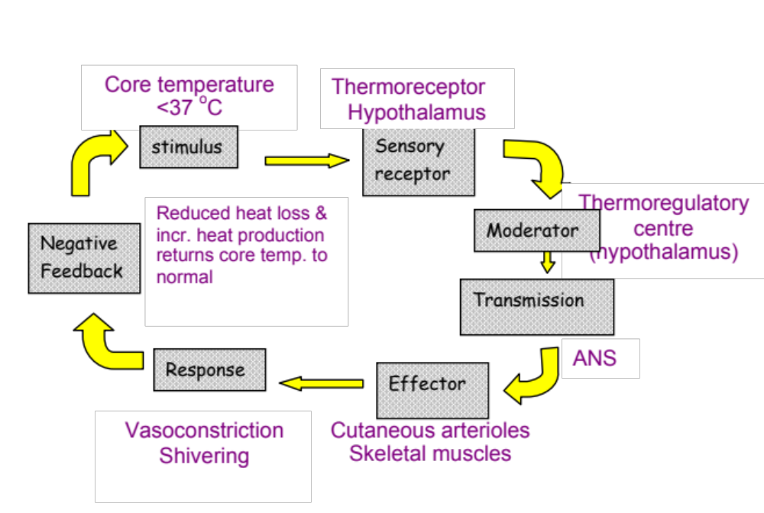
Response to low core temperature

Slide 18
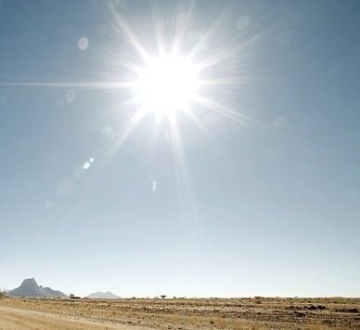
Response to high temperature

Slide 19
Vasodilation
Vasodilation: increase blood flow to the skin. The process is the opposite to vasoconstriction. This results in greater heat loss via radiation and convection.

Slide 20
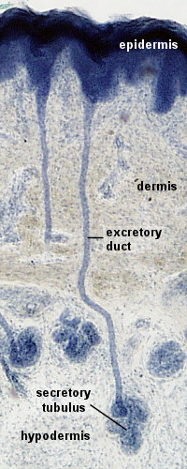
Sweating
Sweat glands secrete sweat, which is carried by the sweat duct onto the surface of the skin. Sweating results in heat loss by evaporation.

Slide 21
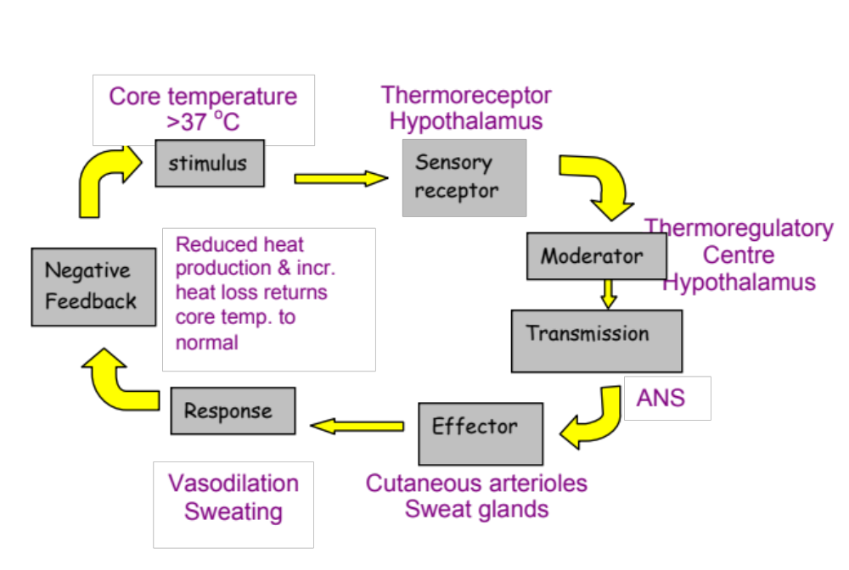
Response to high core temperature

